Slide 1
Evolution of Quarterback Performance in the NFL (2001–Present)
Justin Sere
BSAN 360
03/20/2026
GitHub: https://github.com/justinsere/Justin-Sere-BSAN360-Final-Project-

Slide 2
Dataset Overview
For this project, I chose to take data from NFL Passing Statistics (2001–Present) to answer questions about how passing in the NFL has changed over the history of the league.
Source: https://www.kaggle.com/datasets/rishabjadhav/nfl-passing-statistics-2001-2023
Size: ~2,350 rows, 27 columns
Each row represents a QB's performance in one season.

Slide 3
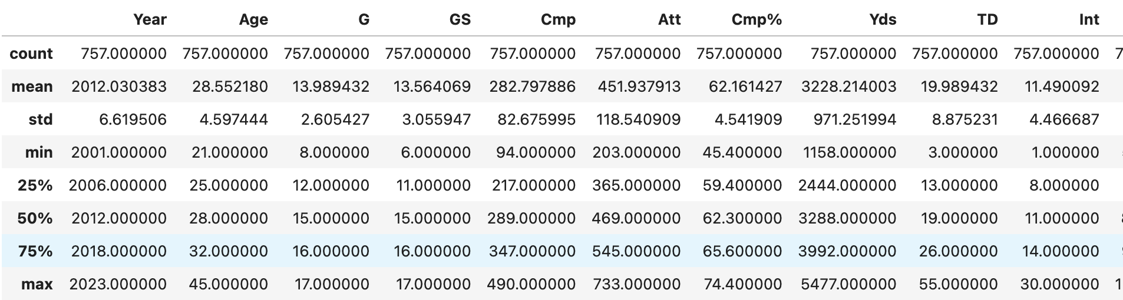
Key Variables & Summary of Statistics
Key Variables:
Passing Yards (Yds)
Touchdowns (TD)
Interceptions (Int)
Passer Rating (Rate)
Attempts (Att)

Slide 4
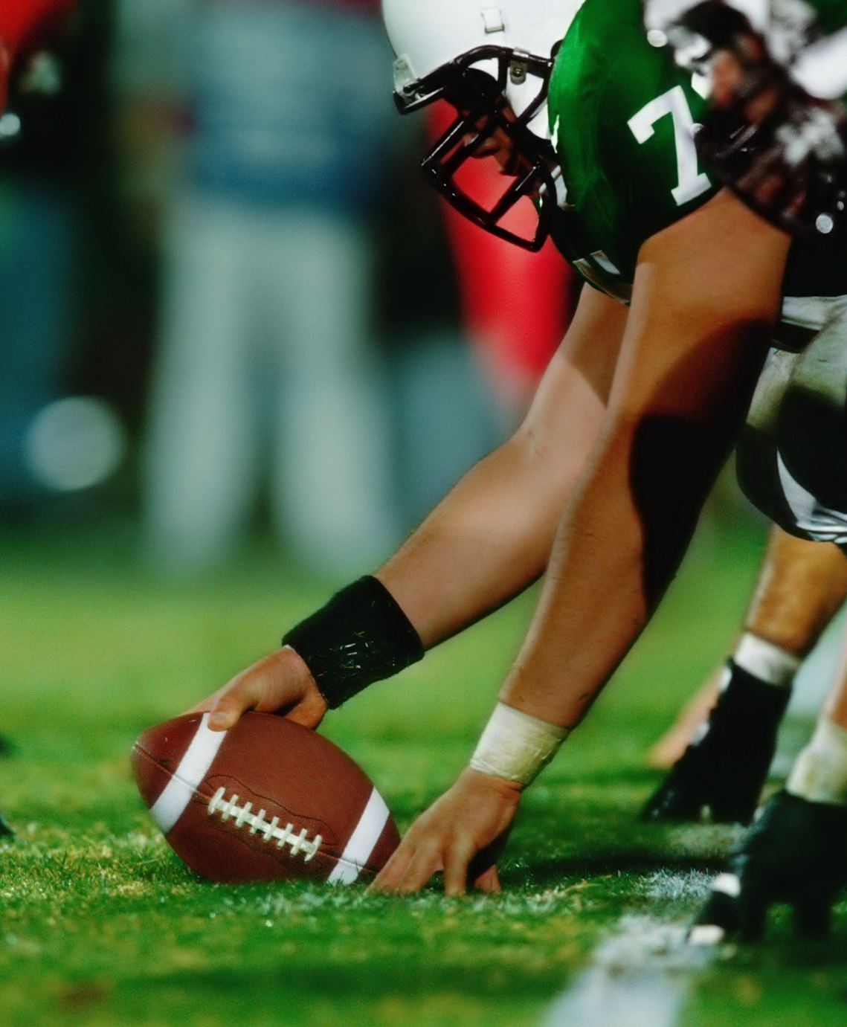
Research Questions
1. How have passing yards changed over time?
2. What factors predict passer rating?
3. Are modern quarterbacks more efficient than earlier ones?

Slide 5
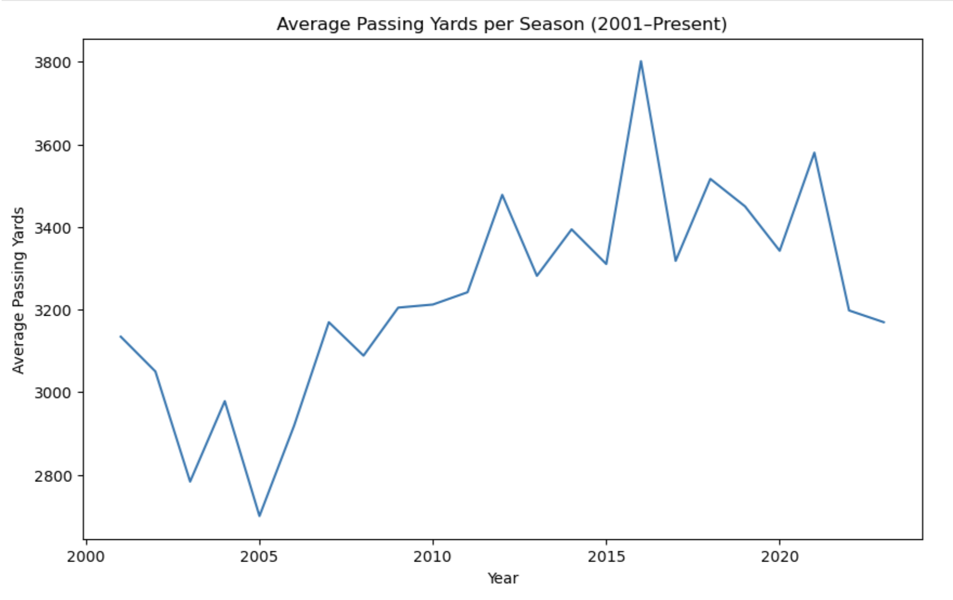
Trend: Passing Yards Over Time
Passing yards have steadily increased over time, reflecting a shift toward pass-heavy offenses and rule changes favoring passing.

Slide 6
Trend Interpretation
The increase in passing yards is likely driven by:
Rule changes (Illegal contact enforcement in 2004 is a great example of a rule change that would impact this)
Increased QB protection
Evolution of offensive schemes
Spikes/dips may reflect standout QB classes, or on the other hand a season full of injuries

Slide 7
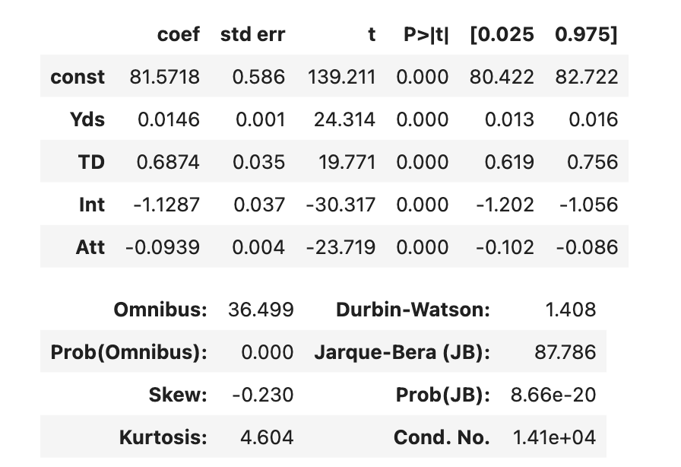
Regression Results
[Insert regression output]
Focus on:
- Coefficients
- p-values
- R-squared

Slide 8
Regression Interpretation
Touchdowns have a strong positive effect on passer rating.
Interceptions significantly decrease rating.
Yards contribute positively but are less impactful than TD/INT.
This suggests efficiency and decision-making are more important than volume of passes alone.

Slide 9
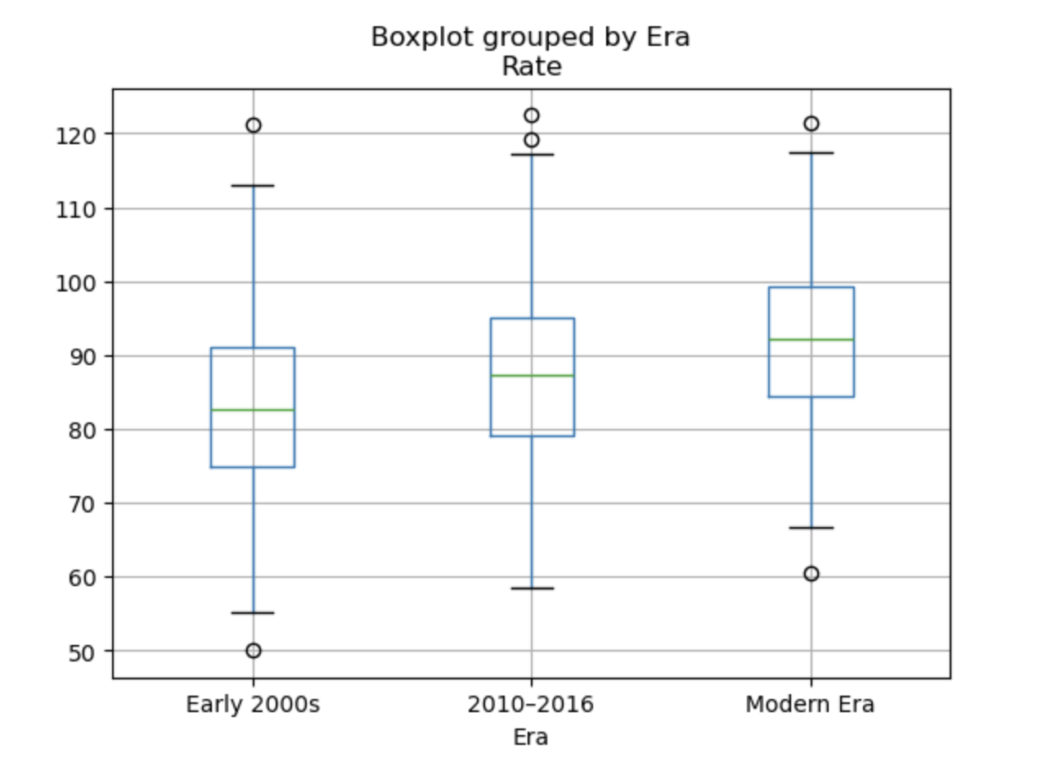
Efficiency by Era
Passer rating appears higher in modern eras compared to early 2000s.

Slide 10
ANOVA Results & Interpretation
Since p-value of 4.759e-17 < 0.05:
There is a statistically significant difference in QB efficiency across eras.
Modern QBs benefit from improved coaching, analytics, and favorable rules.

Slide 11
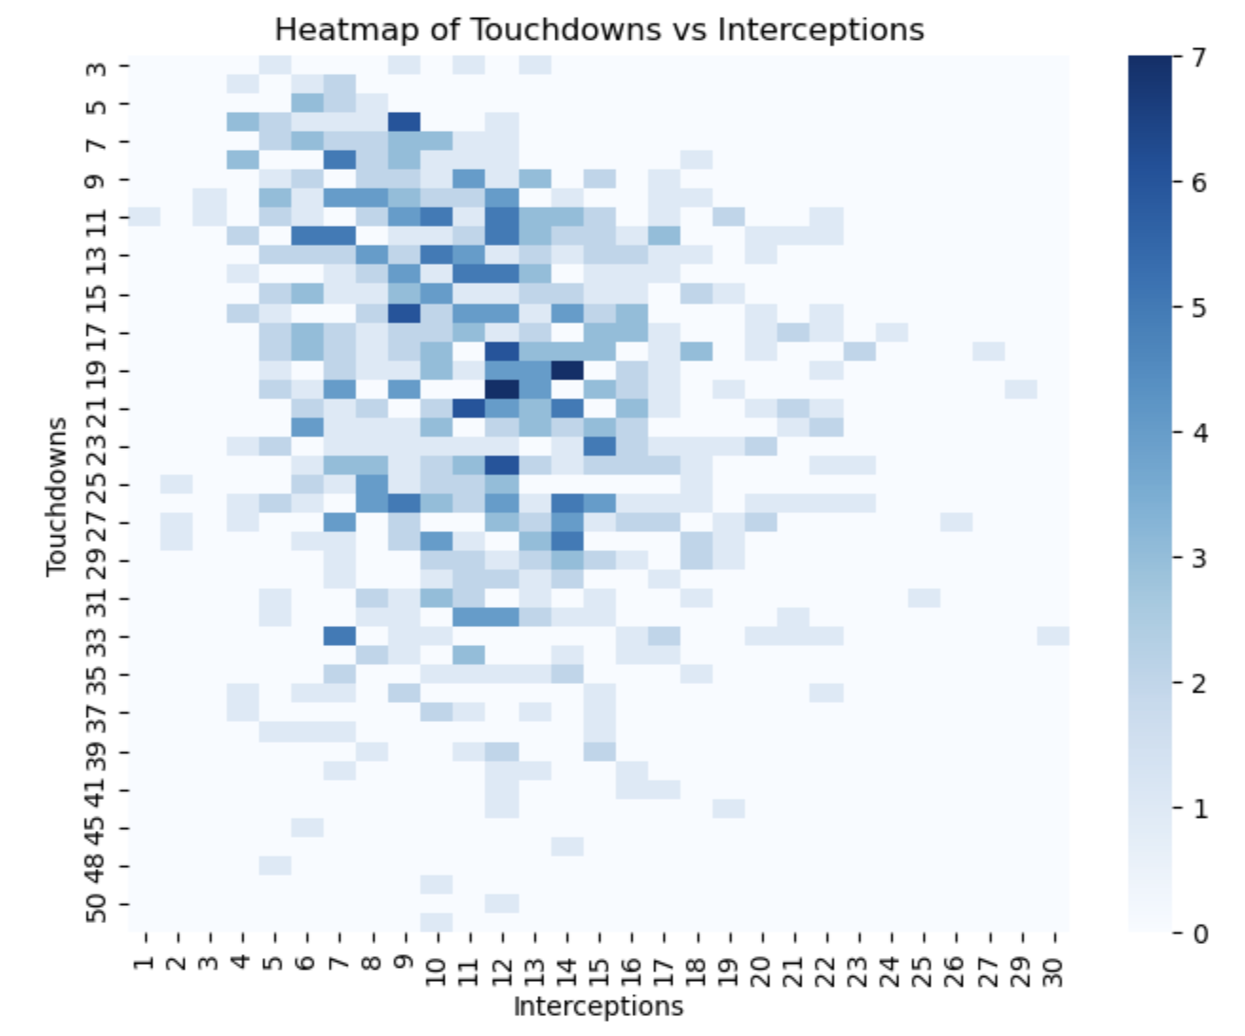
Touchdowns vs Interceptions Heatmap
Interpretation:
Most QBs cluster around moderate TD and low INT values.
Elite seasons (high TD, low INT) are rare, showing difficulty in achieving both volume and efficiency.

Slide 12
Conclusion & Recommendations
Key Findings:
Passing plays in the NFL have increased over time
Efficiency has improved in Quarterbacks
TD and INT are the strongest predictors of a good or bad passer rating in the NFL
Recommendations:
Prioritize decision-making in play-calling (reduce INTs)
Focus on efficient passing strategies rather than letting QB freestyle
Adapt to modern pass-heavy trends while taking other recommendations into factor

